Slide 1
AI for Workforce
Week 3: Industry 4.0 Digitalization

Slide 2
Legal Disclaimers
The Intel® Digital Readiness Programs and Intel® AI for Workforce program are developed by Intel Corporation.
© Intel Corporation. Intel, the Intel logo, and other Intel marks are trademarks of Intel Corporation or its subsidiaries. Other names and brands may be claimed as the property of others. All rights reserved. Program dates and lesson plans are subject to change.
Intel technologies may require enabled hardware, software, or service activation.
No product or component can be absolutely secure.
Results have been estimated or simulated.
Intel does not control or audit third-party data. You should consult other sources to evaluate accuracy.
Your costs and results may vary.

Slide 3

Recap

Slide 4
Agenda
What is digitalization?
How is AI used in various industries?

Slide 5
What is Digitalization?

Slide 6
Digitalization
What is digitalization?
Digitalization vs digitized
Why digitalization?
How to create successful digitalization?

Slide 7
What is Digitalization?
The Definition
“Digitalization is the conversion of written and oral communication to electronic messaging that everyone understands.”
Simply put, communication is now in a digital form that can be processed and manipulated by a computer. We can gain new insights and make informed decisions using this data.
Digitalisation: Why you should digitalise your business and how to succeed. Andreas Grundsell. February 18, 2021. https://www.pagero.com/blog/digitalisation-why-digitalise-your-business
Notes:
One of the definitions for Digitalization.
Digitalisation: Why you should digitalise your business and how to succeed. Andreas Grundsell. February 18, 2021. https://www.pagero.com/blog/digitalisation-why-digitalise-your-business

Slide 8
There are two terminologies. Digitalization and Digitization. What are the differences?
Notes:
You can ask the students what could be the differences between the two words.

Slide 9
Digitalization vs Digitization
Let’s understand the differences
Before we proceed, let’s clear up the difference between digitalize and digitize
To digitalize is to transform the entire business using digital processes
E.g., using SAP software to handle company’s financial documents digitally
Data is readily usable in digital format
To digitize refers to conversion from a physical format into a digital one
E.g., scanning a paper invoice and creating a PDF document
Notes:
Digitalisation: Why you should digitalise your business and how to succeed. Andreas Grundsell. February 18, 2021. https://www.pagero.com/blog/digitalisation-why-digitalise-your-business

Slide 10

Why Digitalization?
The benefits include:
Disrupting the industry. E.g., Uber vs taxi.
Improving efficiency as compared to manual work. E.g., sorting through millions of transactions easily using software.
Improving user experience. E.g., concept table of using interactive AR at Pizza Hut while waiting for food.
[Video] Pizza Hut - Chaotic Moon Studios Interactive Concept Table. Yourdailyfunvideos. Mar 6, 2014. https://www.youtube.com/watch?v=UzRZRyPReJk
Notes:
7 Reasons Why You Need to Start Business Digitalization Right Now. RabIT software engineering. April 10, 2018. https://www.rabitse.com/blog/7-reasons-behind-business-digitization/
[Video] Pizza Hut - Chaotic Moon Studios Interactive Concept Table. Yourdailyfunvideos. Mar 6, 2014. https://www.youtube.com/watch?v=UzRZRyPReJk

Slide 11
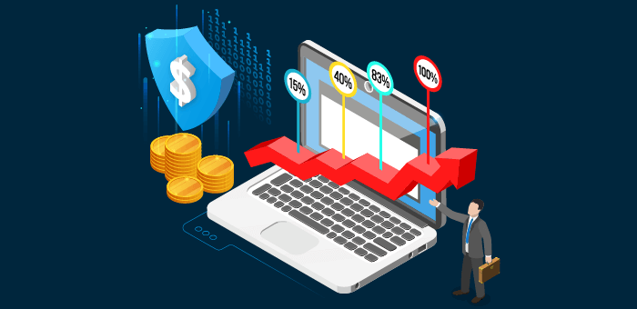
Why Digitalization?
The benefits include:
Increasing customer base. More customers accessing the website through mobile.
Utilizing new tech. E.g., Amazon use AI to predict customer behavior.
Having higher process efficiency, lower transaction costs, and better control.
https://rencore.com/wp/wp-content/uploads/2020/01/Rise-of-digital-economy_PostBanner.png
Notes:
7 Reasons Why You Need to Start Business Digitalization Right Now. RabIT software engineering. April 10, 2018. https://www.rabitse.com/blog/7-reasons-behind-business-digitization/

Slide 12
Why Digitalization?
The benefits include:
Integrating conventional digitized record system.
Improving accessibility and better information exchange.
Increasing response time as data is readily searchable.
Having the ability to take advantage of analytics.
Notes:
The importance of digitalization. Chakib Abi-Saab. January 5, 2015. https://www.enterpriseitnews.com.my/the-importance-of-digitalization/

Slide 13
We have gone through its benefits. How do we implement a good digitalization strategy?
Notes:
You can ask the students what are their thoughts on the differences.

Slide 14
How to Create a Successful Digitalization Strategy?
The necessary steps include:
Have a clear goal and purpose
Leadership support
Empowering workers to change
Clear communication on the benefits
Training the employees to learn digitalization
Notes:
The importance of digitalization. Chakib Abi-Saab. January 5, 2015. https://www.enterpriseitnews.com.my/the-importance-of-digitalization/

Slide 15
AI for Various Industries

Slide 16
Do you remember, during Week 1, we went over AI examples in industries?

Slide 17
AI for Various Industries
Let’s discuss
What are the AI technologies you have seen or experienced?
How are they applicable to our lives?
What improvements do you think these technologies require?
Notes:
This is an exercise on observation, on how to link everyday AI to the other industries.

Slide 18
Let’s look into them more closely.

Slide 19

AI for Various Industries
We will be covering the following industries:
Retail
Agriculture
Healthcare
Manufacturing
Energy
Transportation
Education
Banking
https://images.app.goo.gl/381KhZN7yabP4JNa9

Slide 20
AI for Various Industries
And for each industry, we will look at:
Background information of the industries
Problems that they face
Some AI solutions out there

Slide 21
Let’s start by looking at the retail industry.

Slide 22
AI in Retail

Slide 23
AI in Retail
Background information about the industry
Retail is the sale of goods or service from a business to a customer.
Some major companies in the United States include Walmart, Amazon, and The Kroger Co.
Retail supports 52 million working Americans.
That’s ¼ of total employments in the United States.
Estimated GDP from retail is $4.56 trillion.
Notes:
What Is Retail? erply.com. https://erply.com/what-is-retail/
Retail Jobs. National Retail Federation. https://nrf.com/insights/economy/about-retail-jobs
National Retail Federation boosts its annual forecast, expects ‘fastest growth that we’ve seen in this country since 1984’. Melissa Repko. JUN 9 2021. https://www.cnbc.com/2021/06/09/retail-sales-to-rise-10point5percent-13point5percent-to-more-than-4point44-trillion-nrf-says.html

Slide 24
AI in Retail
Problems faced in the industry
Competition with online stores and global retailers.
Customers expect a seamless experience.
Maintaining customer base (instilling brand loyalty).
Inspiring and retaining employees.
Adjusting to the new normal after Covid-19.
Notes:
5 Key Challenges Facing Retailers Today – And How to Solve Them. eTail. https://etaileast.wbresearch.com/blog/five-key-challenges-for-retailers-how-to-solve-them
Retail Industry Challenges & Opportunities In 2021. TEAM LINCHPIN. JUNE 17, 2021. https://linchpinseo.com/common-challenges-facing-the-retail-industry/

Slide 25


AI in Retail
AI solutions in the industry
Lowebot, an autonomous robot that navigates aisles and fetches requested products. It improves the ease and efficiency of locating in-store merchandise.
Amazon Go, a self-checkout store. It brings a more convenient way of shopping and paying for the products.
Chatbots to answer customer’s inquiries. This action allows the customers to get their answers quickly.
In-store heat mapping reveals which products are picked up, which are returned, and where the customer goes after leaving the shelf. This is achieved with the help of Camera and Computer Vision and helps create experiences that encourage product engagement and help shoppers learn more.
[Video] Lowe’s Introduces LoweBot. Lowe's Home Improvement. Aug 30, 2016. https://www.youtube.com/watch?v=hP3yfGHTXFo
[Video] Introducing Amazon Go and the world’s most advanced shopping technology. amazon. Dec 5, 2016. https://www.youtube.com/watch?v=NrmMk1Myrxc
Notes:
A Helping Hand. Lowe's Innocation Labs. https://www.lowesinnovationlabs.com/lowebot/
[Video] Lowe’s Introduces LoweBot. Lowe's Home Improvement. Aug 30, 2016. https://www.youtube.com/watch?v=hP3yfGHTXFo
[Video] Introducing Amazon Go and the world’s most advanced shopping technology. amazon. Dec 5, 2016. https://www.youtube.com/watch?v=NrmMk1Myrxc

Slide 26
AI in Retail
Let’s discuss in your group
What other AI solutions can be implemented but not shown in the previous slides?
What are the potential ethical questions that may arise with these AI solutions? And what can you do to reduce the risks?
Your answers should be around 2 paragraphs long (around 100 words).
You should not spend more than 5 minutes for this discussion.
Notes:
Some possible answers, there are no right or wrong answers:
Some other AI solutions include chatbot to facilitate the customers’ purchase, computer vision to recognize customer and offer customized user experience, and automated purchase based on the remaining food in their fridge.
Possible ethical problem include lack of privacy and the reasons for unemployment. To reduce the risk, we should develop AI technologies that can work together with our workers, and not as a replacement.

Slide 27
We have seen how AI is used in the retail industry. Let’s look at how it is used in the agriculture industry.

Slide 28
AI in Agriculture

Slide 29
AI in Agriculture
Background information about the industry
Agriculture is the practice of cultivating plants and livestock
Examples of agricultural products include millets, grains, dairy, animal meat.
Agriculture giants in the United States include Nutrien, Tyson Foods, and CHS Inc.
United States is a net exporter of food.
In 2019, there were 22.2 million American jobs in agriculture. Translating to 10.9% of total United States employment.
Agriculture, food, and related industries contributed $1.1 trillion to the United States’ GDP.
Notes:
Ag and Food Sectors and the Economy. Economic Research Service U.S. DEPARTMENT OF AGRICULTURE. https://www.ers.usda.gov/data-products/ag-and-food-statistics-charting-the-essentials/ag-and-food-sectors-and-the-economy

Slide 30
AI in Agriculture
Problems faced in the industry
Demand for sufficient, safe food increases while food wastage increases.
Large environmental footprint. It occupies 40% of the earth’s surface.
It uses 70% of global water use and emits 11% of global greenhouse gas (high water and carbon footprints).
Climate change, soil erosion, and biodiversity loss make it harder to plant crops.
Inspire young people to stay in rural areas and become future farmers.
Notes:
Three key challenges facing agriculture and how to start solving them. Jonathan Brooks, Koen Deconinck and Céline Giner. 6 June 2019. https://www.oecd.org/agriculture/key-challenges-agriculture-how-solve/
Modern agriculture has many complex challenges. syngenta. https://www.syngenta.com/en/innovation-agriculture/challenges-modern-agriculture

Slide 31
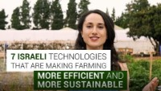
AI in Agriculture
AI solutions in the industry
Analyze market demand to determine which crops to plant. This allows the farmers to prioritize high profit crops to plant while ensuring sufficient food.
Monitoring soil health so that corrective action can be taken improve crop health.
Automatic feeding crops reduces the workload for the farmers.
AI can identify & monitor nutritional deficiencies, diseases and water stress to determine crop health and yield.
[Video] 7 Israeli Agriculture Technologies. Israel. Jan 21, 2019. https://www.youtube.com/watch?v=v1DT4yvxpMw
Notes:
Artificial Intelligence in Agriculture: Rooting Out the Seed of Doubt. Dmytro Lenniy. February 18, 2021. https://www.intellias.com/artificial-intelligence-in-agriculture/
[Video] 7 Israeli Agriculture Technologies. Israel. Jan 21, 2019. https://www.youtube.com/watch?v=v1DT4yvxpMw
[Video] How Singapore Farms Use Artificial Intelligence. CNA Insider. Mar 10, 2020. https://www.youtube.com/watch?v=qOGsz-rUx6E
[Video] Reducing the need for pesticides in agriculture. Robovision. Aug 23, 2021. https://www.youtube.com/watch?v=2exMDMoI9Uk

Slide 32

AI in Agriculture
AI solutions in the industry
Smart irrigation, spraying, and vertical farming allow the farmers to tend to their farms while conserving resources.
Applications of drones and GIS allows the farmers to monitor the health of the farm promptly and with less effort.
AI Weed Detection by VisionAI is capable of reducing the usage of pesticides, therefore, reducing health risk to the consumer and cost to the farmers.
[Video] How Singapore Farms Use Artificial Intelligence. CNA Insider. Mar 10, 2020. https://www.youtube.com/watch?v=qOGsz-rUx6E
Notes:
Artificial Intelligence in Agriculture: Rooting Out the Seed of Doubt. Dmytro Lenniy. February 18, 2021. https://www.intellias.com/artificial-intelligence-in-agriculture/
[Video] 7 Israeli Agriculture Technologies. Israel. Jan 21, 2019. https://www.youtube.com/watch?v=v1DT4yvxpMw
[Video] How Singapore Farms Use Artificial Intelligence. CNA Insider. Mar 10, 2020. https://www.youtube.com/watch?v=qOGsz-rUx6E
[Video] Reducing the need for pesticides in agriculture. Robovision. Aug 23, 2021. https://www.youtube.com/watch?v=2exMDMoI9Uk

Slide 33
AI in Agriculture
Let’s discuss in your group
What other AI solutions can be implemented but not shown in the previous slides?
What are the potential ethical questions that may arise with these AI solutions? And what can you do to reduce the risks?
Your answers should be around 2 paragraphs long (around 100 words).
You should not spend more than 5 minutes for this discussion.
Notes:
Some possible answers, there are no right or wrong answers:
Some other AI solutions include autonomous tractor that can work on its own according to schedule.
Possible ethical problem include reasons for unemployment. To reduce the risk, we should develop AI technologies that can work together with our workers, and not as a replacement.

Slide 34
We have seen how AI is used in the agriculture industry. Now, we will look at the healthcare industry.

Slide 35
AI in Healthcare

Slide 36
AI in Healthcare
Background information about the industry
Healthcare is the area of maintenance or improvement of health via prevention, diagnosis, treatment, and recovery from illness or injury.
This sector includes hospitals, nursing homes, medical devices suppliers, medical insurance companies, and pharmaceuticals.
Some major players include UnitedHealth Group, Johnson and Johnson, and Aetna.
More than 900,000 businesses with over 20 millions employees are working in this sector.
Healthcare spending grew to $3.8 trillion in 2019.
Notes:
Sectors of Healthcare Industry. technofunc. https://www.technofunc.com/index.php/domain-knowledge/healthcare-industry/item/sectors-of-healthcare-industry
Census Bureau’s 2018 County Business Patterns Provides Data on Over 1,200 Industries. EARLENE K.P. DOWELL. OCTOBER 14, 2020. https://www.census.gov/library/stories/2020/10/health-care-still-largest-united-states-employer.html
Historical. cms.gov. https://www.cms.gov/Research-Statistics-Data-and-Systems/Statistics-Trends-and-Reports/NationalHealthExpendData/NationalHealthAccountsHistorical

Slide 37
AI in Healthcare
Problems faced in the industry
Cost and transparency
Consumer experience
Holistic individual health
Accessible points of care
Inadequate staffing and mandatory overtime
Safety on job
Workplace violence
Stress, burnout, and lack of work-life balance
Notes:
The Biggest Issues Facing Healthcare Today. MHE Staff. September 27, 2019. https://www.managedhealthcareexecutive.com/view/biggest-issues-facing-healthcare-today
5 Issues Nurses Face in Their Career. Walden University. https://www.waldenu.edu/online-masters-programs/master-of-science-in-nursing/resource/five-issues-nurses-face-in-their-career
5 Key Challenges for a Doctor Serving Humanity. Sarah Brooks. https://www.prospectivedoctor.com/5-key-challenges-for-a-doctor-serving-humanity/

Slide 38

AI in Healthcare
AI solutions in the industry
AI-assisted robotic surgery to suture narrow blood vessel at Maastricht University Medical Center, Netherlands. This achievement allows precise surgery that speeds up the patients’ recovery.
Stanford University’s research of using AI algorithm to detect skin cancer. This research enables a prompt detection and treatment.
Babylon Health creates a health monitoring system to help people stay healthy. Take a look at the video.
[Video] Babylon Health - apps, patients and sustainable healthcare | Dr Keith Grimes. acmedsci. Jan 7, 2021. https://www.youtube.com/watch?v=yO5VARNjuBw
Notes:
5 Real-World Examples of AI in Healthcare. MAYA RAGHUNANDAN. SEPTEMBER 25, 2018. https://www.kolabtree.com/blog/5-real-world-examples-of-ai-in-healthcare/
37 Examples of AI in Healthcare That Will Make You Feel Better About the Future. Sam Daley. August 12, 2021. https://builtin.com/artificial-intelligence/artificial-intelligence-healthcare
[Video] Babylon Health - apps, patients and sustainable healthcare | Dr Keith Grimes. acmedsci. Jan 7, 2021. https://www.youtube.com/watch?v=yO5VARNjuBw

Slide 39

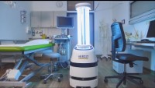
AI in Healthcare
AI solutions in the industry
AI-powered prosthetic arm for amputees, allowing them to have independence in their daily life.
Sensely is a chatbot that can act as an empathy-driven conversational platform.
HERO21, an autonomous disinfection robot used in hospital, especially during a pandemic.
Lucas 3, a chest compression system for CPR on the move that allows the patient to have CPR treatment even in narrow spaces like staircase.
[Video] ARMIS AND CRURA. Arm Chain. Aug 18, 2021. https://www.youtube.com/watch?v=_HhoZhjYq-M
[Video] Game-changer in disinfection - HERO21 autonomous UV-C mobile robot solution for hospitals. Omron Industrial Automation EMEA. Jun 10, 2021. https://www.youtube.com/watch?v=JU8Zy91jaXE
Notes:
[Video] ARMIS AND CRURA. Arm Chain. Aug 18, 2021. https://www.youtube.com/watch?v=_HhoZhjYq-M
Increasing Access. Lowering Costs. Improving Health. sensely. https://www.sensely.com/
[Video] Game-changer in disinfection - HERO21 autonomous UV-C mobile robot solution for hospitals. Omron Industrial Automation EMEA. Jun 10, 2021. https://www.youtube.com/watch?v=JU8Zy91jaXE
[Video] Physio-Control LUCAS 3 - CPR in Motion - Prehospital. MFI Medical Equipment, Inc. Sep 22, 2018. https://www.youtube.com/watch?v=T0O9g0exvEA

Slide 40

AI in Healthcare
Let’s try this App
There are also chatbots that you can talk to
An example is Wysa
You can install it on your Android / iOS phone
You start by choosing a nickname, select a few categories that you are interested in, and start chatting
You can opt to try it out for free (just skip when they ask about paid plans)
[Image of Wysa]. Retrieved on September 12, 2021, from https://www.wysa.io/
Notes:
[Image of Wysa]. Retrieved on September 12, 2021, from https://www.wysa.io/

Slide 41
AI in Healthcare
Let’s discuss in your group
What other AI solutions can be implemented but not shown in the previous slides?
What are the potential ethical questions that may arise with these AI solutions? And what can you do to reduce the risks?
Your answers should be around 2 paragraphs long (around 100 words).
You should not spend more than 5 minutes for this discussion.
Notes:
Some possible answers, there are no right or wrong answers:
Some other AI solutions include automatic prediction for other illness using computer vision. Faster analysis of blood test to determine critical illness.
Possible ethical problem include lack of privacy. To reduce the risk, we should anonymize the data whenever possible, and to restrict access only to the people who need it to carry out their work.

Slide 42
We have seen how AI is used in the healthcare industry. Let’s now look at the manufacturing industry.

Slide 43
AI in Manufacturing

Slide 44
AI in Manufacturing
Background information about the industry
Manufacturing is the creation of products through labor and machinery, usually in the settings of a factory.
Examples of manufacturing include creating pharmaceutical products, chemicals, cars, computers, and clothes.
Manufacturing accounts for 11.39% of total output in the United States.
There are 8.51% workforce employed in this industry.
Notes:
WHAT IS MANUFACTURING? (DEFINITION, TYPES AND EXAMPLES). twi-global. https://www.twi-global.com/technical-knowledge/faqs/faq-what-is-manufacturing
2020 United States Manufacturing Facts. nam.org. https://www.nam.org/state-manufacturing-data/2020-united-states-manufacturing-facts/

Slide 45
AI in Manufacturing
Problems faced in the industry
Shortage of skilled labor.
Accurately predicting the number of demands for the products.
Controlling and tracking the inventory to avoid overstocking.
Improving the efficiency at manufacturing plants so that they can reduce cost, increase the speed, and maintain the quality.
Competitions from other factories around the world.
Notes:
7 Common Manufacturing Challenges & How to Overcome Them. Kanya. November 13, 2018. https://www.hashmicro.com/blog/overcoming-common-manufacturing-challenges/
Top 10 Issues Facing the Manufacturing Industry in 2020. Black Line Group Team. Jul 26, 2020. https://www.blacklinegrp.com/blog/issues-facing-the-manufacturing-industry-2020

Slide 46
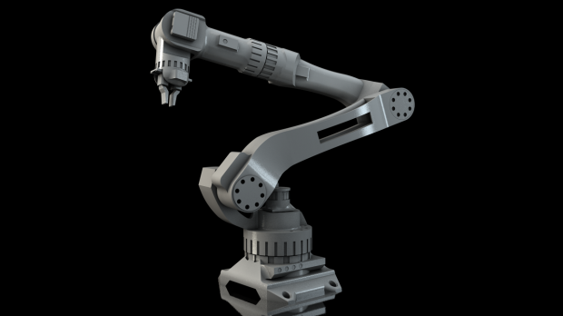
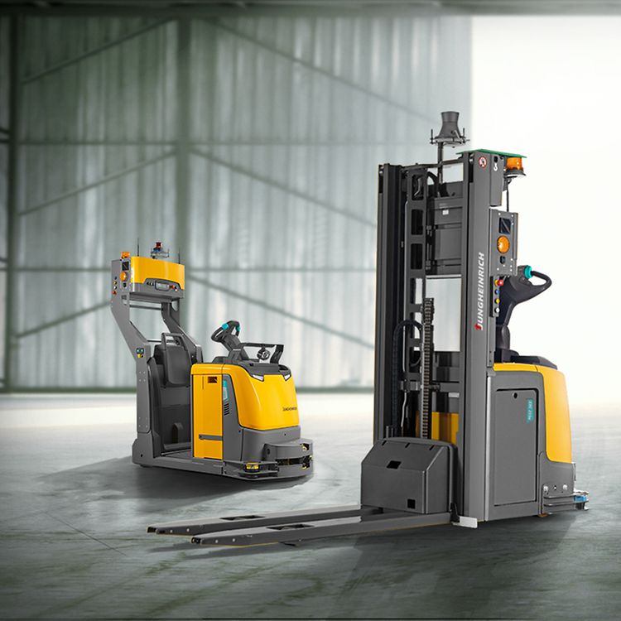
AI in Manufacturing
AI solutions in the industry
Automated Guided Vehicles (AGV) to move the products. This solution improves productivity as they can move heavy objects around the factory.
Robots to build the products. The robots can work 24/7 and ensure consistent quality.
Cameras to check the quality of products. Through computer vision, the system can detect if there are any dents on the packaging.
[Image of robot arm]. Retrieved October 9, 2020, from https://roboticsandautomationnews.com/2018/01/03/30-industrial-robot-manufacturers-to-watch-in-2018/15542/
[Image of automated pallet truck]. Retrieved October 9, 2020, from https://www.jungheinrich.com.sg/systems/automated-guided-vehicle-system/automated-trucks
Notes:
[Image of robot arm]. Retrieved October 9, 2020, from https://roboticsandautomationnews.com/2018/01/03/30-industrial-robot-manufacturers-to-watch-in-2018/15542/
[Image of automated pallet truck]. Retrieved October 9, 2020, from https://www.jungheinrich.com.sg/systems/automated-guided-vehicle-system/automated-trucks

Slide 47
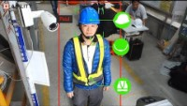
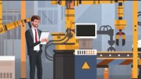
AI in Manufacturing
AI solutions in the industry
Personal Protective Equipment (PPE) detection for workplace safety. Through computer vision, the system can identify if the workers are wearing the PPE correctly for their safety at work.
Visual inspection of weld. Through this innovation, the workers can ensure that early detection of defects on the weld to prevent further loss.
Automating inventory count using drones. Inventory counting is a manual process where the workers need to climb high shelves to count the inventory. The use of drones would make it easier and safer for the workers.
[Video] Construction site safety with Ability AI cameras. Ability EdgeCamera. Apr 17, 2020. https://www.youtube.com/watch?v=tLcYxiNd59w
[Video] AI and Machine Learning for Visual Inspection of Welds. Clear Technologies. Feb 5, 2020. https://www.youtube.com/watch?v=j7bjoI_joZs
Notes:
[Video] Construction site safety with Ability AI cameras. Ability EdgeCamera. Apr 17, 2020. https://www.youtube.com/watch?v=tLcYxiNd59w
[Video] AI and Machine Learning for Visual Inspection of Welds. Clear Technologies. Feb 5, 2020. https://www.youtube.com/watch?v=j7bjoI_joZs
[Video] Automating cycle counting with warehouse drones at CEVA Logistics | Ware. Ware. Apr 1, 2020. https://www.youtube.com/watch?v=nV34cMDfu_0

Slide 48
AI in Manufacturing
Let’s discuss in your group
Based on the two YouTube videos shown just now, how effective are the AI solutions?
What other AI solutions can be implemented but not shown in the previous slides?
What are the potential ethical questions that may arise with these AI solutions? And what can you do to reduce the risks?
Your answers should be around 2 paragraphs long (around 100 words).
You should not spend more than 5 minutes for this discussion.
Notes:
Some possible answers, there are no right or wrong answers:
The AI solutions are as effective as per the trained model and data that is used.
It is effective if the person can be detected correctly.
As with any other camera system, it is dependent on the brightness of the environment (it cannot see in the dark).
Possible ethical problem include lack of privacy and the reasons for unemployment. To reduce the risk, we should develop AI technologies that can work together with our workers, and not as a replacement.

Slide 49
We have seen the advancement of AI in the manufacturing industry. Now, let’s look at the energy industry.

Slide 50
AI in Energy

Slide 51
AI in Energy
Background information about the industry
The energy industry includes the activities of producing and selling energy.
This includes fossil fuel, electrical power, hydropower, nuclear power, and renewable energy.
There are 6.7 million Americans working in the energy sector. This represents 4.6% of the total American workforce.
Notes:
Energy Sector. JAMES CHEN. February 04, 2021. https://www.investopedia.com/terms/e/energy_sector.asp
U.S. Energy and Employment Report. NASEO. https://www.naseo.org/issues/energy-jobs/employment-report

Slide 52
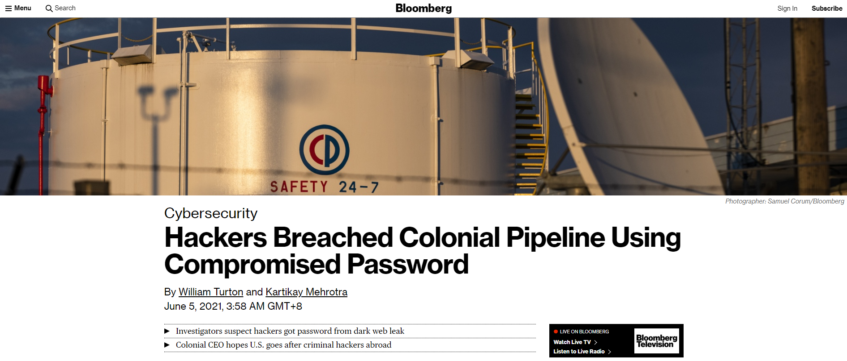
AI in Energy
Problems faced in the industry
Shortfall in oil supply.
Increase in energy demand.
Greenhouse gas emission from fossil fuels.
Energy security.
Unpredictability of the weather for renewable energy.
[Image of cybersecurity hacking] Retrieved on September 12, 2021, from https://www.bloomberg.com/news/articles/2021-06-04/hackers-breached-colonial-pipeline-using-compromised-password
Notes:
The key challenges facing the energy industry of the future. Andrew Bradshaw. Jan 22, 2019. https://www.fifthring.com/articles/the-key-challenges-facing-the-energy-industry-of-the-future
[Image of cybersecurity hacking] Retrieved on September 12, 2021, from https://www.bloomberg.com/news/articles/2021-06-04/hackers-breached-colonial-pipeline-using-compromised-password

Slide 53
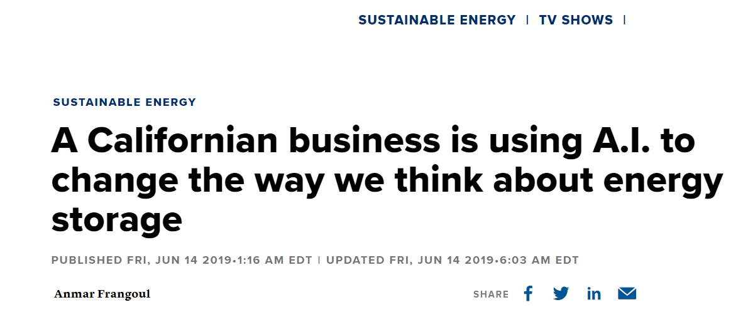
AI in Energy
AI solutions in the industry
AI-managed smart grid to respond to quick changes in energy demand.
DeepMind predicts wind power output 36 hours ahead of actual generation.
Stem uses AI to help firms store renewable energy.
[Image of AI on energy storage] Retrieved on September 12, 2021, from https://www.cnbc.com/2019/06/14/the-business-using-ai-to-change-how-we-think-about-energy-storage.html
Notes:
Artificial Intelligence in the Power Sector. Baloko Makala and Tonci Bakovic. April 2020. https://www.ifc.org/wps/wcm/connect/bd3a196d-a88f-45af-bbc6-e0b00790fba8/EMCompass_Note_81-05-web.pdf?MOD=AJPERES&CVID=n72pj5g
Google’s DeepMind AI Can Predict Wind Farm Energy Output 36 Hours in Advance. RENAE REINTS. February 28, 2019. https://fortune.com/2019/02/27/deepmind-wind-power-predictions/
[Image of AI on energy storage] Retrieved on September 12, 2021, from https://www.cnbc.com/2019/06/14/the-business-using-ai-to-change-how-we-think-about-energy-storage.html

Slide 54
AI in Energy
Let’s discuss in your group
What other AI solutions can be implemented but not shown in the previous slides?
Your answers should be around 2 paragraphs long (around 100 words).
You should not spend more than 5 minutes for this discussion.
Notes:
Some possible answers, there are no right or wrong answers (this encourages creativity from the students):
The AI solutions include determining how much energy is required at a city a few days ahead, using AI to design efficient solar panel.

Slide 55
We have seen some AI solutions in the energy industry. Now, let’s look at the transportation industry.

Slide 56
AI in Transportation

Slide 57
AI in Transportation
Background information about the industry
Transportation industry refers to the services of moving people or goods.
This includes air, rail, marine, truck, transit and ground, scenic and sightseeing.
5.6 millions persons working in transportation and warehousing.
Transportation services contributed $1,066.9 billion to GDP in 2016.
Notes:
What is the U.S. Transportation Sector? Amy Huckaba. Jun 10, 2020. https://blog.dixonvalve.com/us-transportation-sector
Employment in Transportation: Employment in Transportation and Related Industries. Bureau of Transportation Statistics. https://data.bts.gov/stories/s/Transportation-Economic-Trends-Transportation-Empl/caxh-t8jd/
Transportation’s Contribution to the Economy. Bureau of Transportation Statistics. https://www.bts.dot.gov/sites/bts.dot.gov/files/u796/TET%202018%20Chapter%202.pdf

Slide 58
AI in Transportation
Problems faced in the industry
Maintain safe practices. Estimated 21,450 deaths on first half of 2021.
Limited rest stops and challenges in dealing with fatigue management.
Shortage of skilled drivers.
Reducing transportation cost, especially fuel cost.
Congestion.
Notes:
Preliminary Monthly Estimates. NSC. https://injuryfacts.nsc.org/motor-vehicle/overview/preliminary-monthly-estimates
The top 5 issues in the transportation industry. Tess Lynch. https://www.yarno.com.au/blog/top-5-issues-in-transportation/
Top 10 Challenges Logistics Companies Are Facing In 2019. Keshavdas M. January 14, 2021. https://fleetroot.com/blog/top-10-challenges-facing-logistics-companies-in-2019/
Top 10 Challenges Facing Trucking. MH&L. OCT 08, 2008. https://www.mhlnews.com/transportation-distribution/article/22039246/top-10-challenges-facing-trucking

Slide 59

AI in Transportation
AI solutions in the industry
Tesla’s self driving car and Autonomous Semi Truck, making driving safer on the road.
AI systems to predict and prevent traffic jams.
Flying drone taxis.
Google Maps and Waze for planning routes and reaching destination faster.
Didi detects drowsy drivers with AI facial recognition and thus, reducing accidents.
Wired Bikes creates electric balance bikes.
Nuro creates grocery delivery robot.
[Video] The Future of Transportation. Cisco. Oct 24, 2019. https://www.youtube.com/watch?v=Txtj-Xp6REE
Notes:
Examples of AI Implementation in Transport. Varun Choudhary. June 27, 2019. https://hackernoon.com/examples-of-ai-implementation-in-transport-c1a451b90fb7
Examples of Artificial Intelligence Applications in Transportation. Lanner. November 6, 2019. https://www.lanner-america.com/blog/examples-artificial-intelligence-applications-transportation/
China’s Didi uses AI-powered facial recognition feature to boost safety. Soumik Roy. 14 January, 2020. https://techwireasia.com/2020/01/chinas-didi-uses-ai-powered-facial-recognition-feature-to-boost-safety/
[Video] The Future of Transportation. Cisco. Oct 24, 2019. https://www.youtube.com/watch?v=Txtj-Xp6REE
[Video] The best Electric Balance Bike in Australia. Wired Bikes. Nov 30, 2020. https://www.youtube.com/watch?v=w9TDlJj7gn0
Self-driving car company Nuro wins federal safety approval for grocery delivery robot. Ian Duncan. February 8, 2020. https://www.washingtonpost.com/local/trafficandcommuting/grocery-delivery-robot-wins-first-federal-safety-approval-for-a-self-driving-vehicle/2020/02/06/90e97658-48f5-11ea-9164-d3154ad8a5cd_story.html

Slide 60
AI in Transportation
Let’s discuss in your group
What other AI solutions can be implemented but not shown in the previous slides?
What are the potential ethical questions that may arise with these AI solutions? And what can you do to reduce the risks?
Your answers should be around 2 paragraphs long (around 100 words).
You should not spend more than 5 minutes for this discussion.
Notes:
Some possible answers, there are no right or wrong answers:
Some other AI solutions include autonomous taxi and dynamic charging of taxi fares depending on traffic.
Possible ethical problem include lack of privacy and the reasons for unemployment and bias (charging higher for the minorities or to the ladies, for example). To reduce the risk, we should develop AI technologies that can work together with our workers, and not as a replacement.

Slide 61
We have seen how AI is used in the transportation industry. Now, let’s look at the education industry.

Slide 62
AI in Education

Slide 63
AI in Education
Background information about the industry
Education in United States consists of public, private, and home schools.
There are 3.7 million teachers in both private and public-school classrooms.
The national average student to teacher ratio in public school is 16 to 1.
Notes:
Education in the United States. Wikipedia. https://en.wikipedia.org/wiki/Education_in_the_United_States
K-12 School Enrollment & Student Population Statistics. Melanie Hanson. July 30, 2021. https://educationdata.org/k12-enrollment-statistics

Slide 64
AI in Education
Problems faced in the industry
Schools are overcrowded.
School spending is stagnant.
Teacher training method is outdated.
Lack of teacher education & innovation.
School security and safety.
Help for students with disabilities.
Problems with common core curriculum.
Student mental health challenges.
Notes:
18 REASONS THE U.S. EDUCATION SYSTEM IS FAILING. MATTHEW LYNCH. APRIL 3, 2017. https://www.theedadvocate.org/10-reasons-the-u-s-education-system-is-failing/
The 15 Biggest Failures of the American Public Education System. Kate Barrington. May 28, 2019. https://www.publicschoolreview.com/blog/the-15-biggest-failures-of-the-american-public-education-system

Slide 65

AI in Education
AI solutions in the industry
MARTHA, George Washington University’s chatbot, to answer students’ queries.
Jill Watson is an AI teaching assistant at Georgia Institute of Technology’s School of Interactive Computing.
ALEKS is a research-based, online learning program that offers targeted learning based on the student’s actual comprehension of the subject.
[Video] Unleashing the Power of Learning through Jill Watson. Georgia Tech College of Computing. Jan 25, 2020. https://www.youtube.com/watch?v=C79x_tK1mg0
Notes:
Universities Use AI Chatbots to Improve Student Services. Erin Brereton. Oct 25, 2019. https://edtechmagazine.com/higher/article/2019/10/universities-use-ai-chatbots-improve-student-services
AI in Education: Where is It Now and What is the Future? Andrea Kulkarni. September 6, 2019. https://www.lexalytics.com/lexablog/ai-in-education-present-future-ethics
[Video] Unleashing the Power of Learning through Jill Watson. Georgia Tech College of Computing. Jan 25, 2020. https://www.youtube.com/watch?v=C79x_tK1mg0

Slide 66
AI in Education
Let’s discuss in your group
What other AI solutions can be implemented but not shown in the previous slides?
What are the potential ethical questions that may arise with these AI solutions? And what can you do to reduce the risks?
Your answers should be around 2 paragraphs long (around 100 words).
You should not spend more than 5 minutes for this discussion.
Notes:
Some possible answers, there are no right or wrong answers (this encourages creativity of the students):
The AI solutions include automatic exam paper marking, attendance taking, cheat-prevention in examination.
Potential ethical issues include differentiated treatment for the rich, where only rich people can afford the latest AI technologies. To reduce the risk, we can open-source the AI technologies so that everyone can benefit from it.

Slide 67
We have seen how AI is used in the education industry. Now, let’s explore the banking industry.

Slide 68
AI in Banking

Slide 69
AI in Banking
Background information about the industry
The banking sector is the foundation of the financial services group. It is mainly focused on direct saving and lending.
There are several segments – a few include retail banking, commercial banking, and investment banking.
There are over 1.8 million employees in commercial banking in the United States.
Notes:
Financial Services Sector. THE INVESTOPEDIA TEAM. February 23, 2021. https://www.investopedia.com/ask/answers/030315/what-financial-services-sector.asp
Commercial Banking in the US - Employment Statistics 2002–2027. IBISWorld. May 19, 2021. https://www.ibisworld.com/industry-statistics/employment/commercial-banking-united-states/

Slide 70
AI in Banking
Problems faced in the industry
Competition from other banks, from foreign and online banks.
Regulatory compliance.
Rising expectation from consumer.
Customer retention.
Security breaches.
Notes:
Top 10 Banking Industry Challenges — And How You Can Overcome Them. Landy Wingard. https://global.hitachi-solutions.com/blog/top-10-challenges-banking-financial-organizations-can-overcome

Slide 71
AI in Banking
AI solutions in the industry
Erica, a chatbot at Bank Of America, serves more than ten million users and understands almost 500,000 question variants.
Ocrolus’ software allows organizations to make better lending decisions, detect fraudulent documents, and process documents quickly.
ZestFinance uses AI to help companies assess borrowers with little to no credit information or history.
Notes:
Artificial Intelligence in Finance [15 Examples]. University of San Diego. https://onlinedegrees.sandiego.edu/artificial-intelligence-finance/
Intelligent Automation: Faster, More Accurate Lending Decisions. Ocrolus. https://www.ocrolus.com/
AI and the Bottom Line: 20 Examples of Artificial Intelligence in Finance. Alyssa Schroer. July 30, 2021. https://builtin.com/artificial-intelligence/ai-finance-banking-applications-companies

Slide 72
AI in Banking
Let’s discuss in your group
What other AI solutions can be implemented but not shown in the previous slides?
Your answers should be around 2 paragraphs long (around 100 words).
You should not spend more than 5 minutes for this discussion.
Notes:
Some possible answers, there are no right or wrong answers:
The AI solutions include robot-trading, identifying potential financial plans suitable for the customer, customizing the credit cards benefits to the customer.

Slide 73
Now that we have explored the application of AI in various industries, let's shift our focus to the role of generative AI in these industries and how it can be leveraged to further enhance their capabilities and outcomes.

Slide 74

Leveraging Generative AI in Various Industries
Generative AI, with its ability to create and innovate, is revolutionizing various industries.
Let's explore how different sectors, including retail, agriculture, healthcare, manufacturing, energy, transportation, education, and banking, are leveraging the power of Generative AI.

Slide 75

Leveraging Generative AI in Various Industries
Retail Industry:
Personalized product recommendations enhance customer experience.
Virtual try-ons enable customers to visualize products before purchase.
Customized advertisements increase engagement and conversion rates.

Slide 76

Leveraging Generative AI in Various Industries
Agriculture Industry:
Optimized crop yield predictions help farmers improve productivity.
Pest management strategies reduce the use of pesticides and environmental impact.
Precision farming techniques enable efficient resource allocation.

Slide 77

Leveraging Generative AI in Various Industries
Healthcare Industry:
Medical image analysis aids in accurate diagnosis and treatment planning.
Surgical simulations improve surgical outcomes and training.
Personalized treatment plans optimize patient care.

Slide 78

Leveraging Generative AI in Various Industries
Manufacturing Industry:
Optimized product designs through Generative AI led to innovative solutions.
Quality control processes are enhanced, ensuring product excellence.
Predictive maintenance techniques reduce downtime and improve efficiency.

Slide 79

Leveraging Generative AI in Various Industries
Energy Industry:
Demand forecasting enables efficient energy production and distribution.
Energy-efficient building designs contribute to sustainable practices.
Smart grid management enhances energy grid reliability and performance.

Slide 80

Leveraging Generative AI in Various Industries
Transportation Industry:
Real-time traffic predictions aid in route optimization and congestion management.
Autonomous vehicle decision-making ensures safer and more efficient transportation.
Fleet management optimization leads to cost reduction and improved logistics.

Slide 81

Leveraging Generative AI in Various Industries
Education Industry:
Adaptive learning experiences cater to individual student needs.
Virtual tutors provide personalized support and guidance.
Educational simulations create immersive and interactive learning environments.

Slide 82

Leveraging Generative AI in Various Industries
Banking Industry:
Fraud detection algorithms identify and prevent fraudulent activities.
Anomaly detection techniques enhance security and risk management.
Real-time financial data analysis enables informed decision-making.

Slide 83
Leveraging Generative AI in Various Industries has shown immense potential. Let's now delve into a few fascinating case studies highlighting the transformative power of Generative AI in various industries.

Slide 84

Case Study: NVIDIA's Generative AI and Omniverse in Electronics Manufacturing
NVIDIA, a renowned technology company, has made significant strides in the field of generative AI and its application in various industries. One such industry that has witnessed the transformative power of NVIDIA's generative AI is electronics manufacturing. In this case study, we will explore how NVIDIA's generative AI and Omniverse platform have been adopted by leading electronics manufacturers to digitalize their state-of-the-art factories.
Reference: World’s Leading Electronics Manufacturers Adopt NVIDIA Generative AI and Omniverse to Digitalize State-of-the-Art Factories
Notes:
Refer the case study at: https://nvidianews.nvidia.com/news/worlds-leading-electronics-manufacturers-adopt-nvidia-generative-ai-and-omniverse-to-digitalize-state-of-the-art-factories

Slide 85
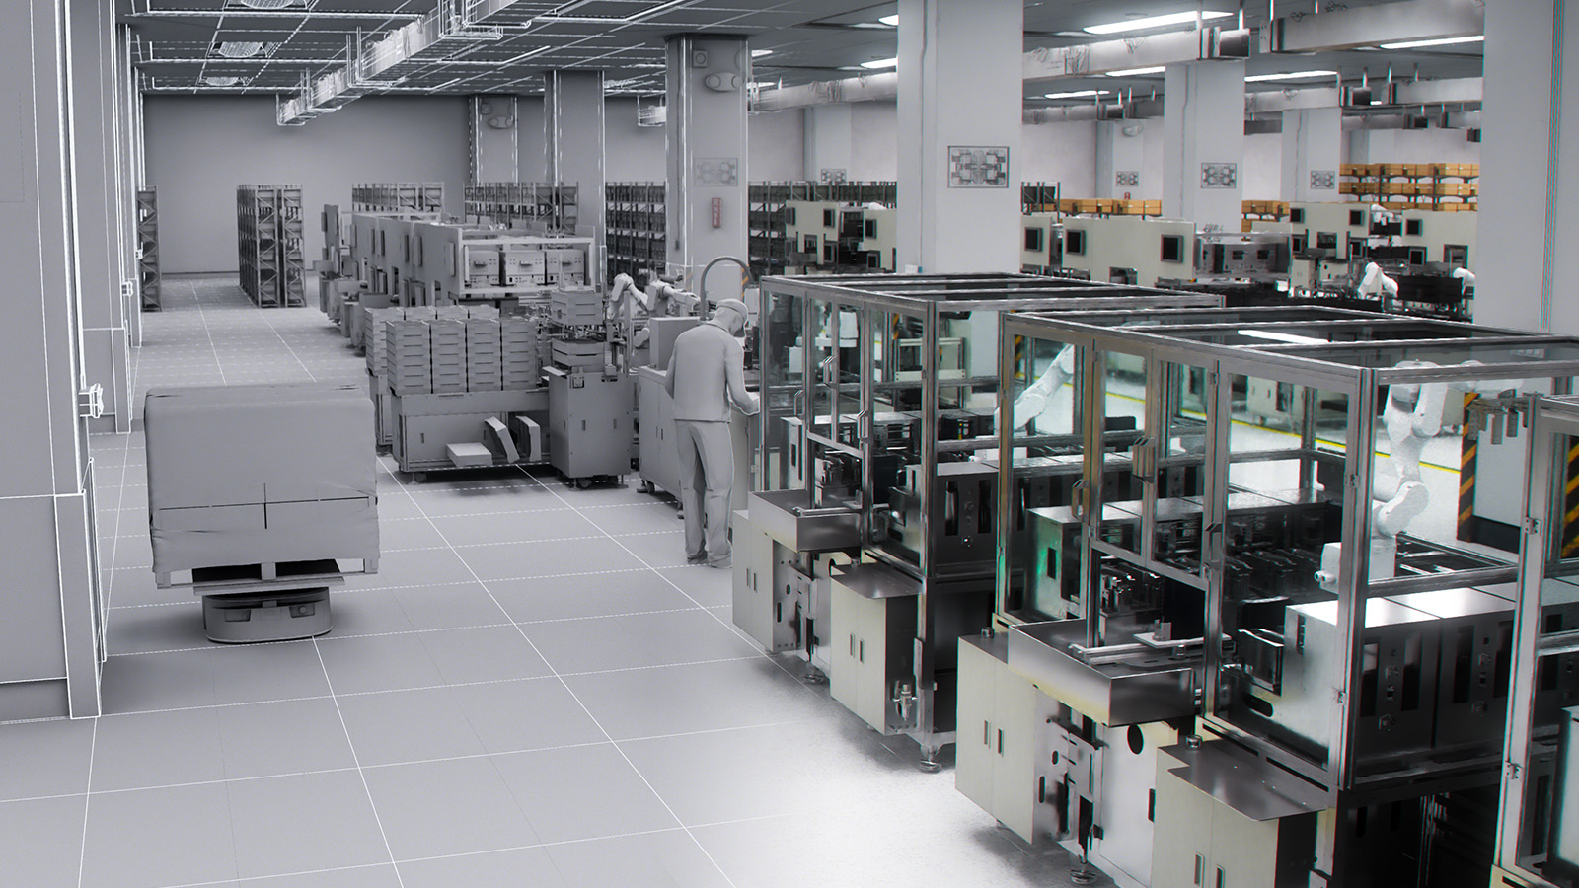
Case Study: NVIDIA's Generative AI and Omniverse in Electronics Manufacturing
NVIDIA's generative AI-powered system can generate realistic and dynamic simulations of factory operations, equipment, and processes.
Image Source - https://s3.amazonaws.com/cms.ipressroom.com/219/files/20234/pegatron-factory-digital-twin.jpg
Notes:
Refer the case study at: https://nvidianews.nvidia.com/news/worlds-leading-electronics-manufacturers-adopt-nvidia-generative-ai-and-omniverse-to-digitalize-state-of-the-art-factories

Slide 86
Case Study: ChatGPT in Healthcare - Revolutionizing Patient Care with Generative AI
Modern Healthcare, a leading digital health publication, partnered with OpenAI to integrate ChatGPT into their healthcare platform. The goal was to leverage generative AI to enhance the communication and support provided to patients.
Reference: Dr. Chatgpt: A Guide To Generative AI In Healthcare
Notes:
Refer the case study at: https://www.modernhealthcare.com/digital-health/chatgpt-healthcare-everything-to-know-generative-ai-artificial-intelligence

Slide 87
Case Study: Leveraging Generative AI in the Energy Sector
The Energy sector plays a vital role in our daily lives, and with the increasing demand for clean and sustainable energy solutions, it is essential to explore innovative technologies. One such technology that is revolutionizing the energy sector is generative AI. In this case study, we will delve into how generative AI is being utilized in the energy sector and the impact it has on the industry.
Reference: How generative AI is coming to the energy sector
Notes:
Refer the case study at: https://www.smart-energy.com/features-analysis/how-generative-ai-is-coming-to-the-energy-sector/

Slide 88
Now that we have explored the exciting possibilities of leveraging generative AI in various industries, let's shift our focus to some of the challenges that organizations face when trying to harness the full potential of this technology.

Slide 89
Challenges in Leveraging Generative AI in Various Industries
Limited Availability Of High-quality Training Data
Generative AI heavily relies on vast amounts of diverse and high-quality data for effective training.
Ethical And Legal Considerations
The use of generative AI raises ethical and legal questions, particularly regarding intellectual property rights and the potential misuse of generated content.

Slide 90
Challenges in Leveraging Generative AI in Various Industries
Computational Resources And Infrastructure
Training and deploying generative AI models often require significant computational resources, including high-performance hardware and infrastructure.
Bias And Fairness Issues
Like any AI system, generative AI models can inherit biases present in the training data, leading to biased or unfair outputs.

Slide 91
Challenges in Leveraging Generative AI in Various Industries
Interpreting And Explaining Generative AI Outputs
Generative AI models produce outputs that can be complex and difficult to interpret.
Integration With Existing Systems And Workflows
Incorporating generative AI into existing industry processes and workflows can be challenging.

Slide 92
We have seen how AI is used in the respective industries. Let’s move on to your assignment.
Notes:
Please open the [Assignment] Week 3.pptx for the instructions on assignment.

Slide 93
Reflection
What is the importance of digitalization?
What are some AI examples used in the various industries?
How might the adoption of generative AI and virtual simulation technologies in fashion designing impact the future fashion world?

Slide 94



Slide 95
Bibliography
Digitalisation: Why you should digitalise your business and how to succeed. Andreas Grundsell. February 18, 2021. https://www.pagero.com/blog/digitalisation-why-digitalise-your-business
7 Reasons Why You Need to Start Business Digitalization Right Now. RabIT software engineering. April 10, 2018. https://www.rabitse.com/blog/7-reasons-behind-business-digitization/
[Video] Pizza Hut - Chaotic Moon Studios Interactive Concept Table. Yourdailyfunvideos. Mar 6, 2014. https://www.youtube.com/watch?v=UzRZRyPReJk
The importance of digitalization. Chakib Abi-Saab. January 5, 2015. https://www.enterpriseitnews.com.my/the-importance-of-digitalization/
WHAT IS MANUFACTURING? (DEFINITION, TYPES AND EXAMPLES). twi-global. https://www.twi-global.com/technical-knowledge/faqs/faq-what-is-manufacturing
2020 United States Manufacturing Facts. nam.org. https://www.nam.org/state-manufacturing-data/2020-united-states-manufacturing-facts/
7 Common Manufacturing Challenges & How to Overcome Them. Kanya. November 13, 2018. https://www.hashmicro.com/blog/overcoming-common-manufacturing-challenges/
Top 10 Issues Facing the Manufacturing Industry in 2020. Black Line Group Team. Jul 26, 2020. https://www.blacklinegrp.com/blog/issues-facing-the-manufacturing-industry-2020
[Image of robot arm]. Retrieved October 9, 2020, from https://roboticsandautomationnews.com/2018/01/03/30-industrial-robot-manufacturers-to-watch-in-2018/15542/
[Image of automated pallet truck]. Retrieved October 9, 2020, from https://www.jungheinrich.com.sg/systems/automated-guided-vehicle-system/automated-trucks

Slide 96
Bibliography
[Video] Construction site safety with Ability AI cameras. Ability EdgeCamera. Apr 17, 2020. https://www.youtube.com/watch?v=tLcYxiNd59w
[Video] AI and Machine Learning for Visual Inspection of Welds. Clear Technologies. Feb 5, 2020. https://www.youtube.com/watch?v=j7bjoI_joZs
[Video] Automating cycle counting with warehouse drones at CEVA Logistics | Ware. Ware. Apr 1, 2020. https://www.youtube.com/watch?v=nV34cMDfu_0
What Is Retail? erply.com. https://erply.com/what-is-retail/
Retail Jobs. National Retail Federation. https://nrf.com/insights/economy/about-retail-jobs
National Retail Federation boosts its annual forecast, expects ‘fastest growth that we’ve seen in this country since 1984’. Melissa Repko. JUN 9 2021. https://www.cnbc.com/2021/06/09/retail-sales-to-rise-10point5percent-13point5percent-to-more-than-4point44-trillion-nrf-says.html
5 Key Challenges Facing Retailers Today – And How to Solve Them. eTail. https://etaileast.wbresearch.com/blog/five-key-challenges-for-retailers-how-to-solve-them
Retail Industry Challenges & Opportunities In 2021. TEAM LINCHPIN. JUNE 17, 2021. https://linchpinseo.com/common-challenges-facing-the-retail-industry/
A Helping Hand. Lowe's Innocation Labs. https://www.lowesinnovationlabs.com/lowebot/
[Video] Lowe’s Introduces LoweBot. Lowe's Home Improvement. Aug 30, 2016. https://www.youtube.com/watch?v=hP3yfGHTXFo
Introducing Amazon Go and the world’s most advanced shopping technology. amazon. Dec 5, 2016. https://www.youtube.com/watch?v=NrmMk1Myrxc
Education in the United States. Wikipedia. https://en.wikipedia.org/wiki/Education_in_the_United_States

Slide 97
Bibliography
K-12 School Enrollment & Student Population Statistics. Melanie Hanson. July 30, 2021. https://educationdata.org/k12-enrollment-statistics
18 REASONS THE U.S. EDUCATION SYSTEM IS FAILING. MATTHEW LYNCH. APRIL 3, 2017. https://www.theedadvocate.org/10-reasons-the-u-s-education-system-is-failing/
The 15 Biggest Failures of the American Public Education System. Kate Barrington. May 28, 2019. https://www.publicschoolreview.com/blog/the-15-biggest-failures-of-the-american-public-education-system
Universities Use AI Chatbots to Improve Student Services. Erin Brereton. Oct 25, 2019. https://edtechmagazine.com/higher/article/2019/10/universities-use-ai-chatbots-improve-student-services
AI in Education: Where is It Now and What is the Future? Andrea Kulkarni. September 6, 2019. https://www.lexalytics.com/lexablog/ai-in-education-present-future-ethics
[Video] Unleashing the Power of Learning through Jill Watson. Georgia Tech College of Computing. Jan 25, 2020. https://www.youtube.com/watch?v=C79x_tK1mg0
Ag and Food Sectors and the Economy. Economic Research Service U.S. DEPARTMENT OF AGRICULTURE. https://www.ers.usda.gov/data-products/ag-and-food-statistics-charting-the-essentials/ag-and-food-sectors-and-the-economy
Three key challenges facing agriculture and how to start solving them. Jonathan Brooks, Koen Deconinck and Céline Giner. 6 June 2019. https://www.oecd.org/agriculture/key-challenges-agriculture-how-solve/
Modern agriculture has many complex challenges. syngenta. https://www.syngenta.com/en/innovation-agriculture/challenges-modern-agriculture
Artificial Intelligence in Agriculture: Rooting Out the Seed of Doubt. Dmytro Lenniy. February 18, 2021. https://www.intellias.com/artificial-intelligence-in-agriculture/

Slide 98
Bibliography
[Video] 7 Israeli Agriculture Technologies. Israel. Jan 21, 2019. https://www.youtube.com/watch?v=v1DT4yvxpMw
[Video] How Singapore Farms Use Artificial Intelligence. CNA Insider. Mar 10, 2020. https://www.youtube.com/watch?v=qOGsz-rUx6E
[Video] Reducing the need for pesticides in agriculture. Robovision. Aug 23, 2021. https://www.youtube.com/watch?v=2exMDMoI9Uk
Sectors of Healthcare Industry. technofunc. https://www.technofunc.com/index.php/domain-knowledge/healthcare-industry/item/sectors-of-healthcare-industry
Census Bureau’s 2018 County Business Patterns Provides Data on Over 1,200 Industries. EARLENE K.P. DOWELL. OCTOBER 14, 2020. https://www.census.gov/library/stories/2020/10/health-care-still-largest-united-states-employer.html
Historical. cms.gov. https://www.cms.gov/Research-Statistics-Data-and-Systems/Statistics-Trends-and-Reports/NationalHealthExpendData/NationalHealthAccountsHistorical
The Biggest Issues Facing Healthcare Today. MHE Staff. September 27, 2019. https://www.managedhealthcareexecutive.com/view/biggest-issues-facing-healthcare-today
5 Issues Nurses Face in Their Career. Walden University. https://www.waldenu.edu/online-masters-programs/master-of-science-in-nursing/resource/five-issues-nurses-face-in-their-career
5 Key Challenges for a Doctor Serving Humanity. Sarah Brooks. https://www.prospectivedoctor.com/5-key-challenges-for-a-doctor-serving-humanity/
5 Real-World Examples of AI in Healthcare. MAYA RAGHUNANDAN. SEPTEMBER 25, 2018. https://www.kolabtree.com/blog/5-real-world-examples-of-ai-in-healthcare/

Slide 99
Bibliography
37 Examples of AI in Healthcare That Will Make You Feel Better About the Future. Sam Daley. August 12, 2021. https://builtin.com/artificial-intelligence/artificial-intelligence-healthcare
[Video] Babylon Health - apps, patients and sustainable healthcare | Dr Keith Grimes. acmedsci. Jan 7, 2021. https://www.youtube.com/watch?v=yO5VARNjuBw
[Video] ARMIS AND CRURA. Arm Chain. Aug 18, 2021. https://www.youtube.com/watch?v=_HhoZhjYq-M
Increasing Access. Lowering Costs. Improving Health. sensely. https://www.sensely.com/
[Video] Game-changer in disinfection - HERO21 autonomous UV-C mobile robot solution for hospitals. Omron Industrial Automation EMEA. Jun 10, 2021. https://www.youtube.com/watch?v=JU8Zy91jaXE
[Video] Physio-Control LUCAS 3 - CPR in Motion - Prehospital. MFI Medical Equipment, Inc. Sep 22, 2018. https://www.youtube.com/watch?v=T0O9g0exvEA
[Image of Wysa]. Retrieved on September 12, 2021, from https://www.wysa.io/
Financial Services Sector. THE INVESTOPEDIA TEAM. February 23, 2021. https://www.investopedia.com/ask/answers/030315/what-financial-services-sector.asp
Commercial Banking in the US - Employment Statistics 2002–2027. IBISWorld. May 19, 2021. https://www.ibisworld.com/industry-statistics/employment/commercial-banking-united-states/
Top 10 Banking Industry Challenges — And How You Can Overcome Them. Landy Wingard. https://global.hitachi-solutions.com/blog/top-10-challenges-banking-financial-organizations-can-overcome

Slide 100
Bibliography
Artificial Intelligence in Finance [15 Examples]. University of San Diego. https://onlinedegrees.sandiego.edu/artificial-intelligence-finance/
Intelligent Automation: Faster, More Accurate Lending Decisions. Ocrolus. https://www.ocrolus.com/
AI and the Bottom Line: 20 Examples of Artificial Intelligence in Finance. Alyssa Schroer. July 30, 2021. https://builtin.com/artificial-intelligence/ai-finance-banking-applications-companies
What is the U.S. Transportation Sector? Amy Huckaba. Jun 10, 2020. https://blog.dixonvalve.com/us-transportation-sector
Employment in Transportation: Employment in Transportation and Related Industries. Bureau of Transportation Statistics. https://data.bts.gov/stories/s/Transportation-Economic-Trends-Transportation-Empl/caxh-t8jd/
Transportation’s Contribution to the Economy. Bureau of Transportation Statistics. https://www.bts.dot.gov/sites/bts.dot.gov/files/u796/TET%202018%20Chapter%202.pdf
Preliminary Monthly Estimates. NSC. https://injuryfacts.nsc.org/motor-vehicle/overview/preliminary-monthly-estimates
The top 5 issues in the transportation industry. Tess Lynch. https://www.yarno.com.au/blog/top-5-issues-in-transportation/
Top 10 Challenges Logistics Companies Are Facing In 2019. Keshavdas M. January 14, 2021. https://fleetroot.com/blog/top-10-challenges-facing-logistics-companies-in-2019/
Top 10 Challenges Facing Trucking. MH&L. OCT 08, 2008. https://www.mhlnews.com/transportation-distribution/article/22039246/top-10-challenges-facing-trucking

Slide 101
Bibliography
Examples of AI Implementation in Transport. Varun Choudhary. June 27, 2019. https://hackernoon.com/examples-of-ai-implementation-in-transport-c1a451b90fb7
Examples of Artificial Intelligence Applications in Transportation. Lanner. November 6, 2019. https://www.lanner-america.com/blog/examples-artificial-intelligence-applications-transportation/
China’s Didi uses AI-powered facial recognition feature to boost safety. Soumik Roy. 14 January, 2020. https://techwireasia.com/2020/01/chinas-didi-uses-ai-powered-facial-recognition-feature-to-boost-safety/
[Video] The Future of Transportation. Cisco. Oct 24, 2019. https://www.youtube.com/watch?v=Txtj-Xp6REE
[Video] The best Electric Balance Bike in Australia. Wired Bikes. Nov 30, 2020. https://www.youtube.com/watch?v=w9TDlJj7gn0
Self-driving car company Nuro wins federal safety approval for grocery delivery robot. Ian Duncan. February 8, 2020. https://www.washingtonpost.com/local/trafficandcommuting/grocery-delivery-robot-wins-first-federal-safety-approval-for-a-self-driving-vehicle/2020/02/06/90e97658-48f5-11ea-9164-d3154ad8a5cd_story.html
What is the U.S. Transportation Sector? Amy Huckaba on Jun 10, 2020. https://blog.dixonvalve.com/us-transportation-sector
Energy Sector. JAMES CHEN. February 04, 2021. https://www.investopedia.com/terms/e/energy_sector.asp
U.S. Energy and Employment Report. NASEO. https://www.naseo.org/issues/energy-jobs/employment-report

Slide 102
Bibliography
The key challenges facing the energy industry of the future. Andrew Bradshaw. Jan 22, 2019. https://www.fifthring.com/articles/the-key-challenges-facing-the-energy-industry-of-the-future
[Image of cybersecurity hacking] Retrieved on September 12, 2021, from https://www.bloomberg.com/news/articles/2021-06-04/hackers-breached-colonial-pipeline-using-compromised-password
Artificial Intelligence in the Power Sector. Baloko Makala and Tonci Bakovic. April 2020. https://www.ifc.org/wps/wcm/connect/bd3a196d-a88f-45af-bbc6-e0b00790fba8/EMCompass_Note_81-05-web.pdf?MOD=AJPERES&CVID=n72pj5g
Google’s DeepMind AI Can Predict Wind Farm Energy Output 36 Hours in Advance. RENAE REINTS. February 28, 2019. https://fortune.com/2019/02/27/deepmind-wind-power-predictions/
[Image of AI on energy storage] Retrieved on September 12, 2021, from https://www.cnbc.com/2019/06/14/the-business-using-ai-to-change-how-we-think-about-energy-storage.html

